Slide 1

OCEAN Case
Group 1
Quoc Phong Tran
Clifford Lin

Slide 2
Agenda
Background environment
Benefits of recycling
About our website

Slide 3
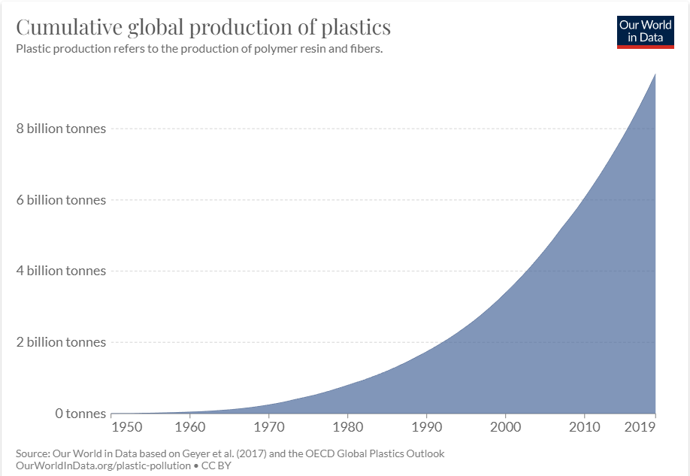
Background
More than 9 billion tons of plastic have been produced so far in 2019.
About 460 million tons of plastic will be used in 2019

Slide 4
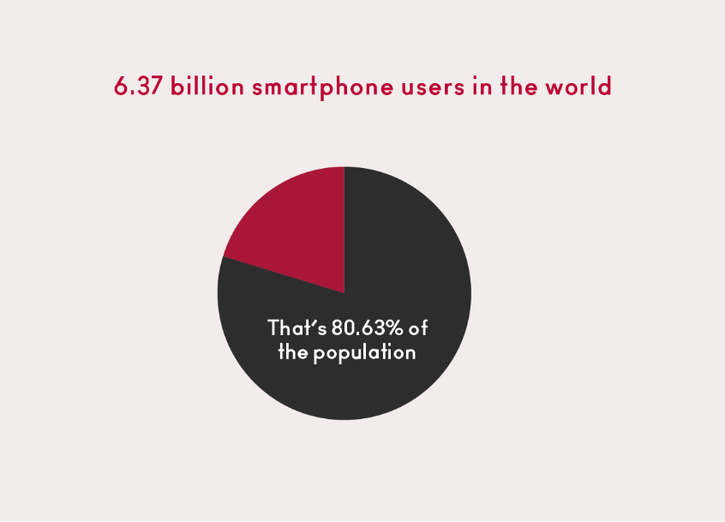
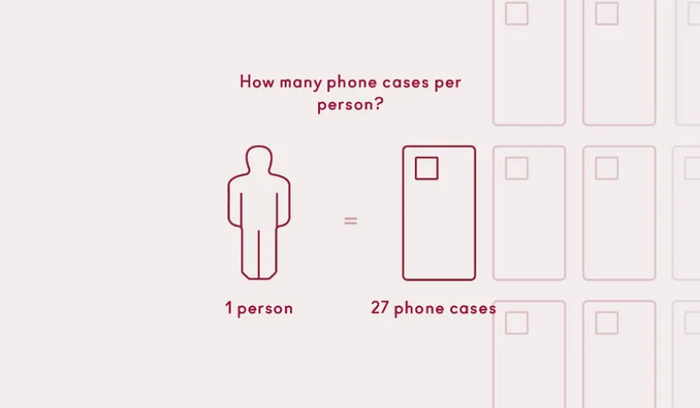
The Fact of Phone Cases

Slide 5
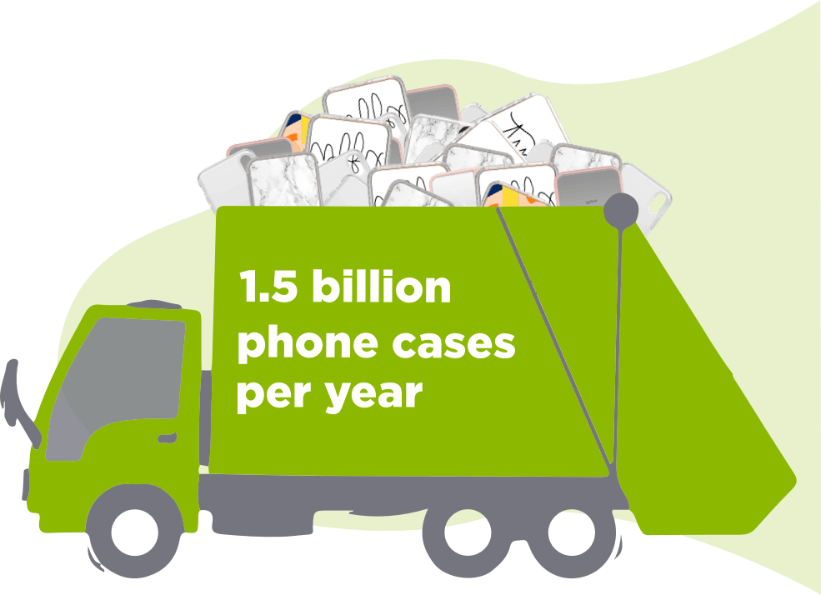
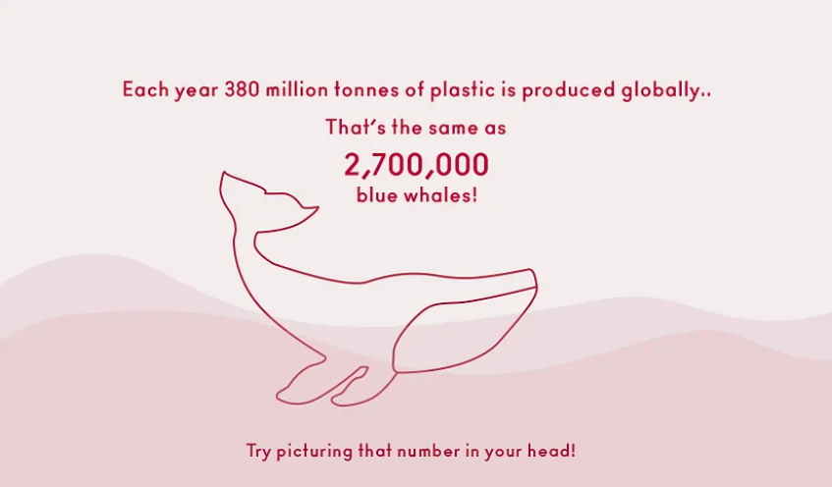
Cont.

Slide 6
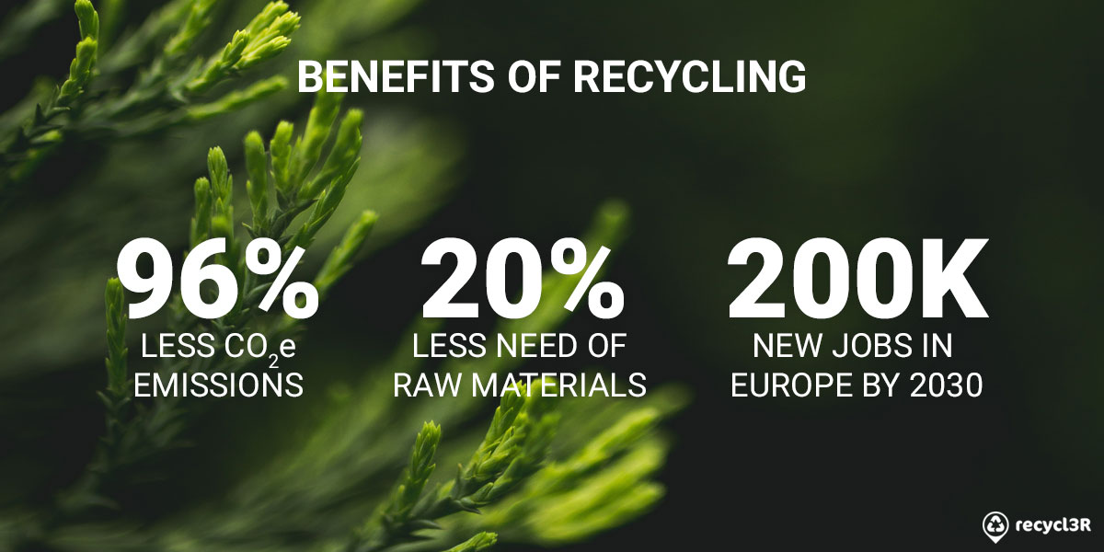

Slide 7
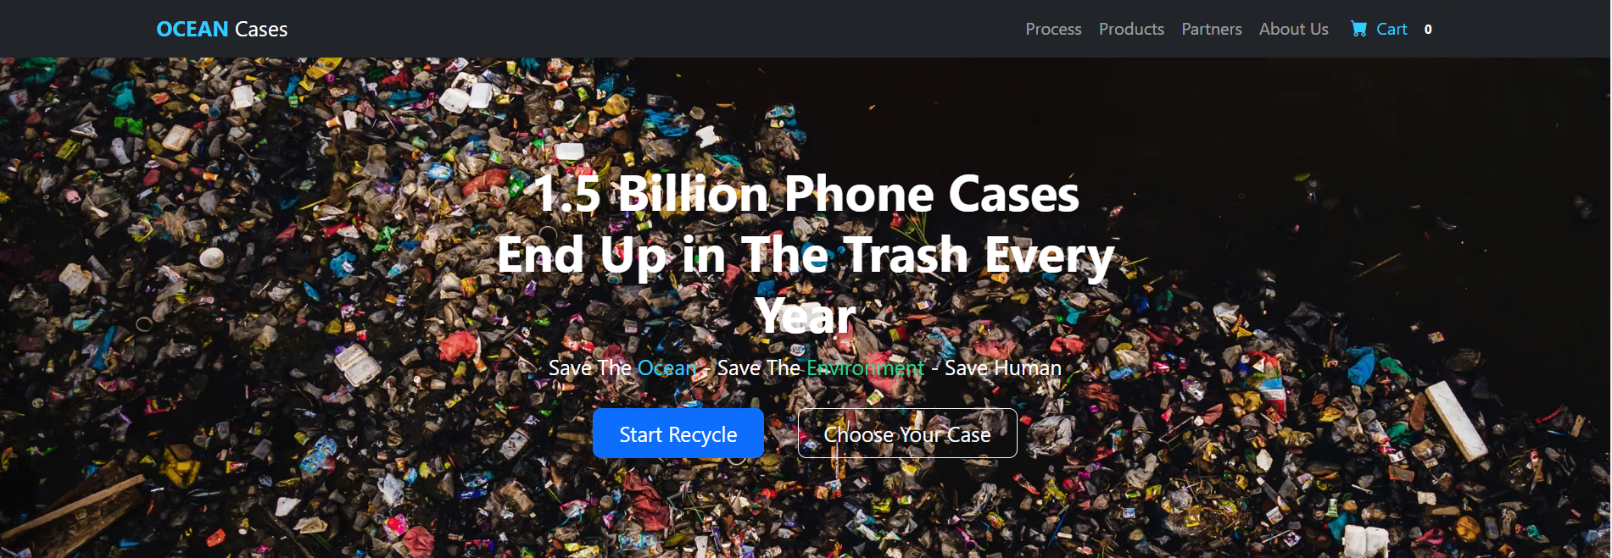
OCEAN Case Website
Vision
Waste-free future
Sustainable practices
Innovative solutions
Mission
Greater sustainability
Educate and empower customers
Collaborate for impact

Slide 8
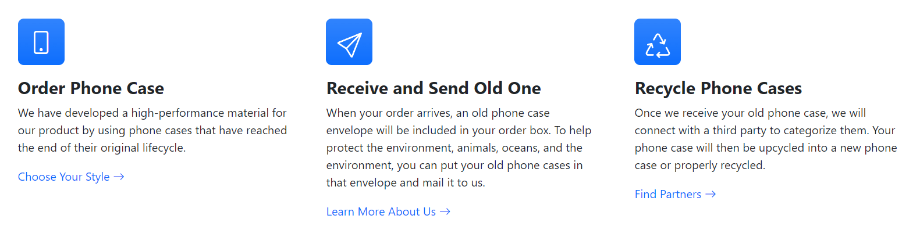
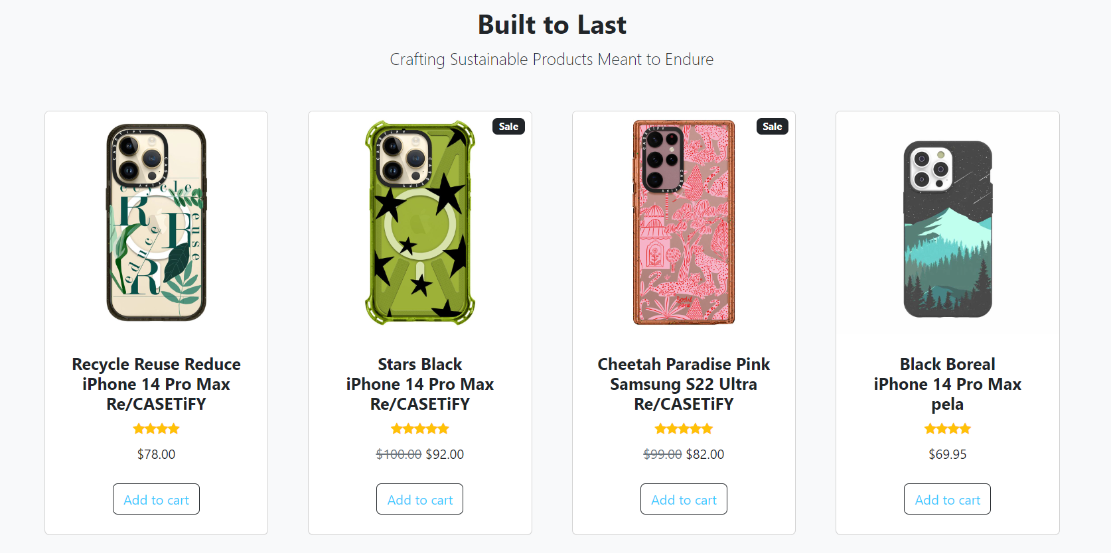
Cont.
The process of recycling phone cases
All products are made by recycling

Slide 9
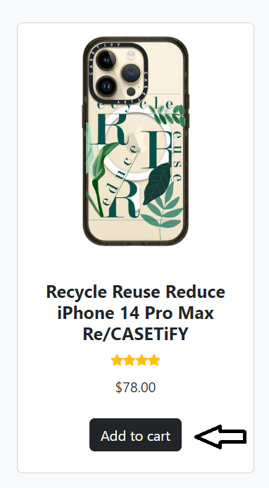
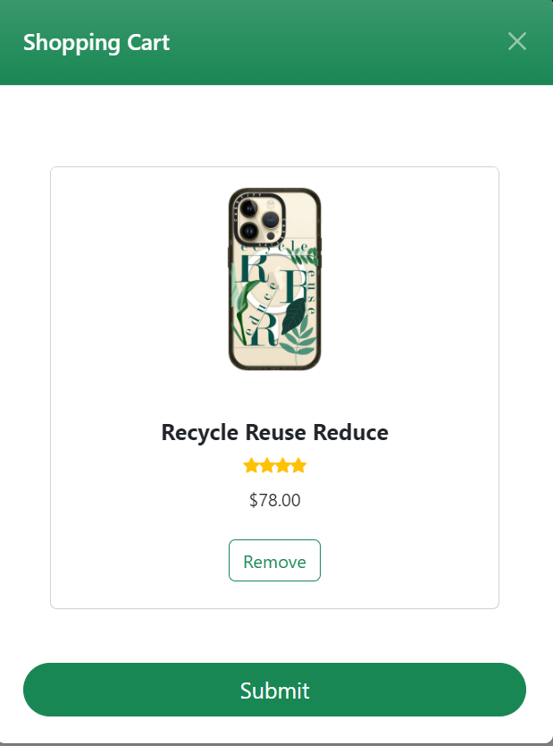
Cont.

Slide 10
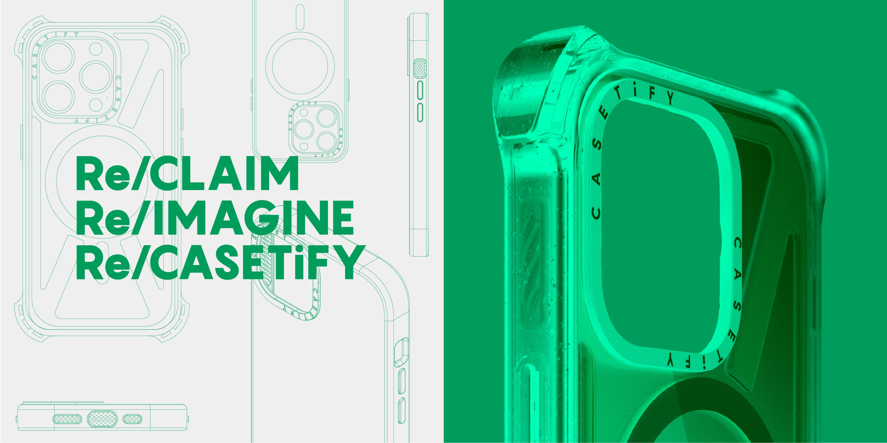

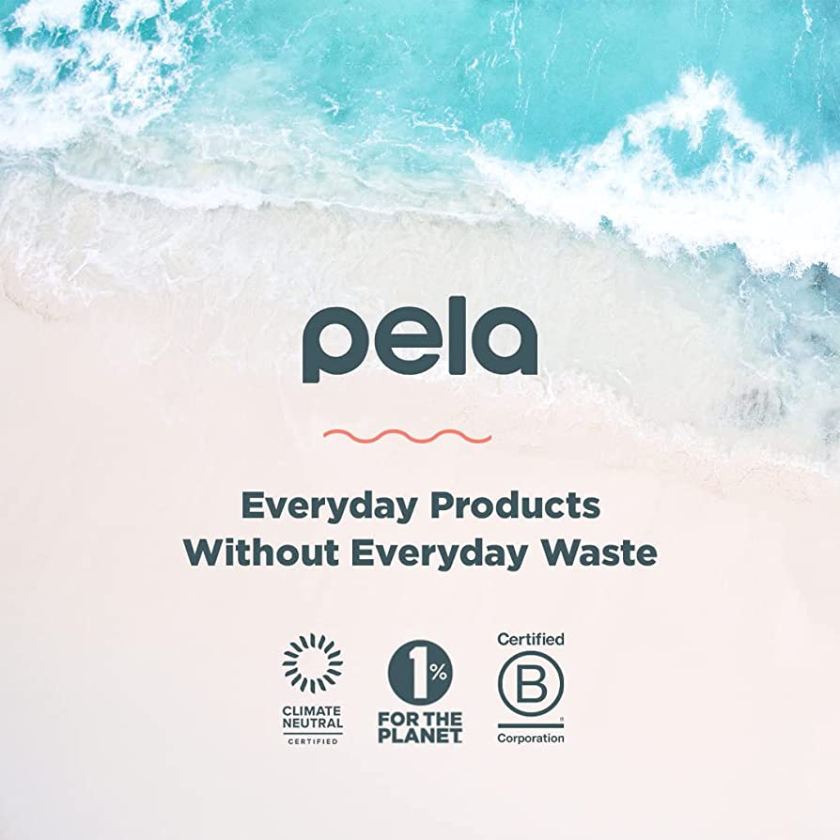
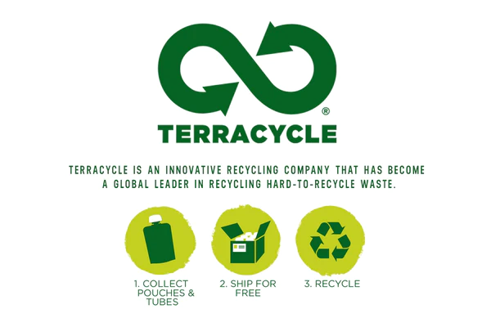
Partners

Slide 11
References
https://ourworldindata.org/plastic-pollution
https://sanjoserecycles.org/guide/phone-cases/
https://aa-88162.medium.com/the-1-billion-plastic-phone-case-problem-4f4431e227ce

